Slide 1
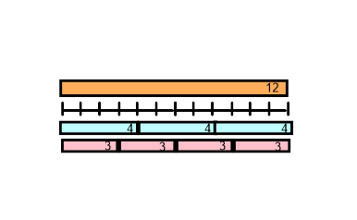
Division Skills 1
Early Stages
Later Stages
Division skill: Sharing
Children learn to share sets of objects between sets eg. 10 spots shared between two ladybird wings; sharing toy animals between fields; putting pennies in purses etc.
Children learn that grouping is a more efficient strategy than sharing and reaches the same answer. All later stages, including written methods for division use grouping.
The language of grouping is different to that of sharing. See purple box below.
24 ÷ 4 =
The language of sharing is: ‘24 divided by 4’
The language of grouping is ‘How many 4s in 24?’ or ‘24 divided into 4s’
Division skill: Linking division and multiplication
Arrays are useful to show how division and multiplication are linked
Knowledge of the link between division and multiplication is essential to solve the following calculations:
x 7 = 392 24 x = 408
12 ÷ 3 = 4 12 ÷ 4 = 3 3 x 4 = 12 4 x 3 = 12
Bar models also show the connection between ÷ and x
Cuisennaire rods are useful to show the connection between multiplication and division. The bar model also show this relationship clearly. Numicon used in layers can also show the link: How many 4s are there in 12, and 4 x 3 = 12. The division ITP (interactive teaching programme) is also very good to illustrate division.

Slide 2
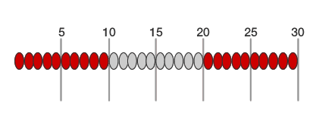
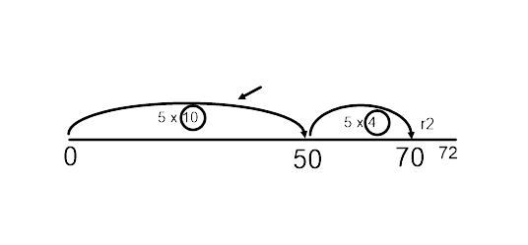
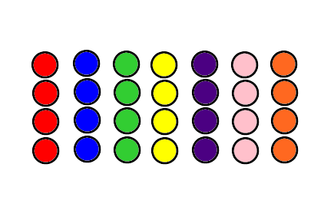
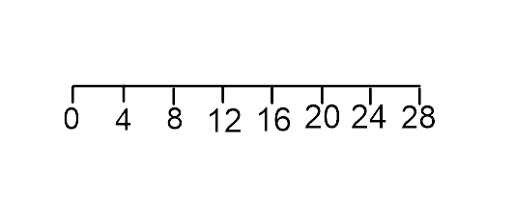
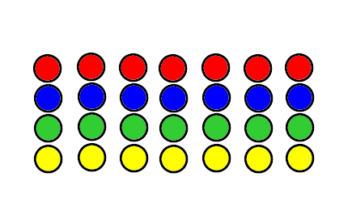
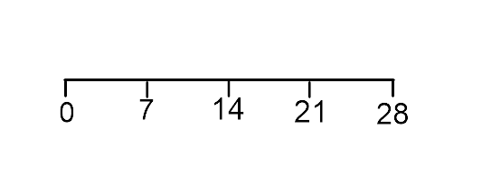
Division Skills 2
Early Stages
Later Stages
Division skill: Grouping (repeated addition)
30 ÷ 5 = 6
How many 5s
are there in 30?
30 divided into 5s
Splitting Method:
Number lines are used to show groups (or repeated addition). As children become more confident they show groups in larger chunks.
We can add 10 groups of 5 in one chunk
72 ÷ 5 = ?
This shows how many 4s are in 28, or 28 divided into 4s.
The bar model shows how a number can be split into ‘ten lots of’ and a remaining amount
5
72
This shows how many 7s are in 28, or 28 divided into 7s.
50
22
The use of the bar model gives children good skills in estimating an answer to a division question.
eg. 547 ÷ 7 is going to be 70 ish
This shows how many 6s are in 30
Bead strings, numicon, cuisennaire and number lines all help to show groups of a number clearly.
The bar model represents the size of the number and how it can be split into multiples of the divisor.
7
547
490
57

Slide 3
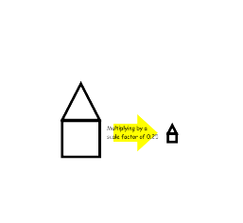
Division Skills 3
Early Stages
Later Stages
Division skill: Dividing by 10 and 100
Work with pupils on looking for the pattern when finding:
40 ÷ 10 = 4
70 ÷ 10 = 7
160 ÷ 10 = 16
Questions such as:
How many m in 204 cm?
Children apply their knowledge to ÷ by 1000
They use knowledge of ÷ by 10/100 to calculate questions such as; Convert 24m into km.
Link to base ten and place value
Division skill: Scaling
Questions such as:
The supermarket sells a 500ml bottle of squash for 69p and a 1.5L bottle for £1.99. Which is better value for money?
Ensure pupils have the opportunity to consider what happens to area, eg:
Children experience problems such as:
Dad is 30 and exactly 5 times older than Sam. How old is Sam?
Division skill: Using what you know
Link between division and fractions
‘½ of something’ is the same as dividing something by 2
Fluency of division facts:
Secure knowledge of multiplication tables and the link between the two concepts will enable children to derive division facts quickly. Use number triangles to
help pupils link multiplication and division facts.
560 ÷ 7 = 80
5.6 ÷ 7 = 0.8
56 ÷ 7 = 8
÷ 7 = 80
21
8 x 7 = 56
56 ÷ 8 = 7
3
7

Slide 4
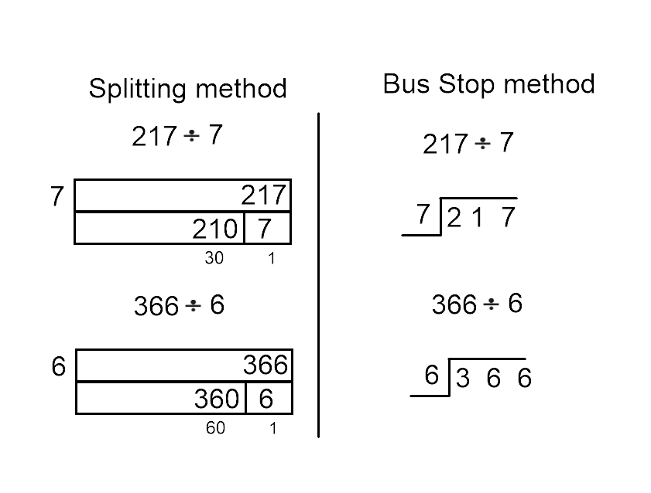
Division Skills 4
Early Stages
Later Stages
Division skill: Using a written method
Children are encouraged to see the link between the splitting method and the short division ‘bus stop’ method. The bar model develops numbers sense, the ‘bus stop’ method is used to solve the calculation.
The use of the bar model gives children good skills in estimating an answer to a division question.
eg. 547 ÷ 7 is going to be 70 ish
Short division
‘bus stop method’
7
547
490
57
70
The bus stop method leads onto long division when the numbers involved become bigger eg. 684 ÷ 17
Approximation to give a sensible answer should be encouraged in all division calculations. In the later stages of division the remainder should be divided equally to give a fraction/decimal answer if relevant for the context of the division. .

